Slide 1
Data Analytics with Tableau
A Practical Approach to Data-Driven Insights
MUDAMANCHU GURUNAGESH (22P31A05A2)
Aditya College of Engineering & Technology (A)
Department of Computer Science and Engineering
Academic Year: 2025–2026

Slide 2
Introduction to Internship
The internship was part of APSCHE–SmartBridge collaboration focused on providing real-time, industry-oriented learning.
The main objective was to gain hands-on experience in Data Analytics and Visualization using Tableau.

Slide 3
Learning Objectives
• Gain practical experience in Data Analytics
• Build interactive dashboards using Tableau
• Learn data cleaning and visualization
• Understand consumer insights and storytelling
• Develop presentation and analytical skills

Slide 4
Organization Overview
APSCHE–SmartBridge partnership offers students practical exposure to technologies like Data Analytics, AI, and Cloud Computing.
Vision: To empower students with practical technology skills.
Mission: To bridge academia and industry through experiential learning.

Slide 5
Project:VISULATION TOOL FOR ELECTRIC VEHICLE CHARGE AND RANGE ANALYSIS
Objective: To analyze electrical vehicle sales.
Dataset:Indian elecricalVehicles.csv
Tools: Tableau, Excel, Google Sheets, MySQL
Outcome: Created dashboards showing insights into product sales performance.

Slide 6
Tools & Technologies Used
• Tableau – Visualization and dashboard creation
• MySQL – Data querying
• Microsoft Excel – Data cleaning
• Google Sheets – Preprocessing
• GitHub – Project repository management

Slide 7
Weekly Activities Summary
• Week 1–2: Learned data analytics basics and SQL operations
• Week 3–4: Built dashboards and explored Tableau features
• Week 5–6: Applied storytelling and created project dashboards
• Week 7–8: Completed documentation, GitHub upload, and final evaluation

Slide 8
Skills Acquired
Technical Skills:
• Tableau dashboard design
• SQL querying and data cleaning
• Data storytelling and visualization
Soft Skills:
• Communication and teamwork
• Problem-solving and time management

Slide 9
Internship Outcomes
• Learned to interpret business data effectively
• Developed analytical thinking
• Understood visualization for decision-making
• Improved technical and managerial competencies

Slide 10
Work Environment & Experience
The internship provided a supportive virtual learning environment with mentor guidance.
Collaboration, self-learning, and feedback were integral parts, enhancing professional confidence.

Slide 11
Conclusion
The internship enhanced both technical and professional skills in Data Analytics.
It strengthened my understanding of visualization and prepared me for real-world data-driven roles.

Slide 12
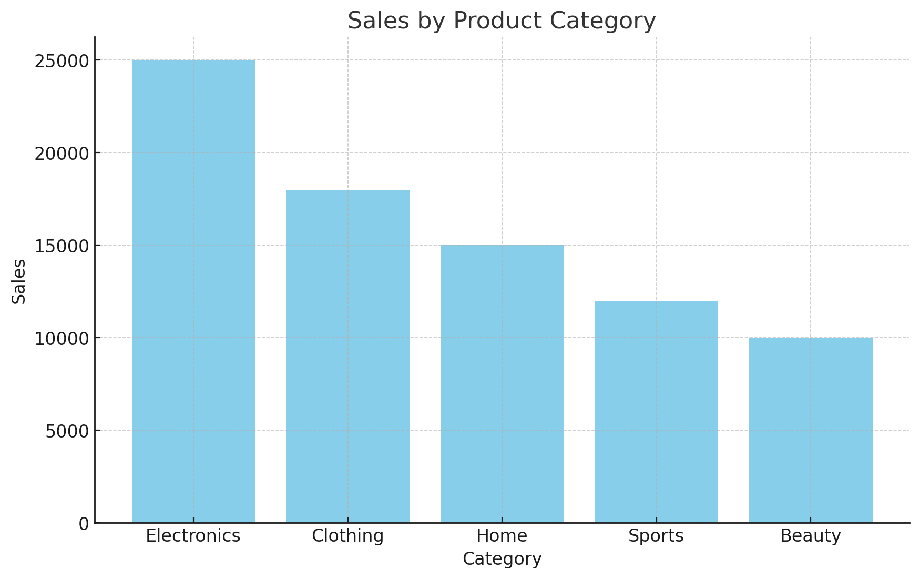
Sales by vehicles Category

Slide 13
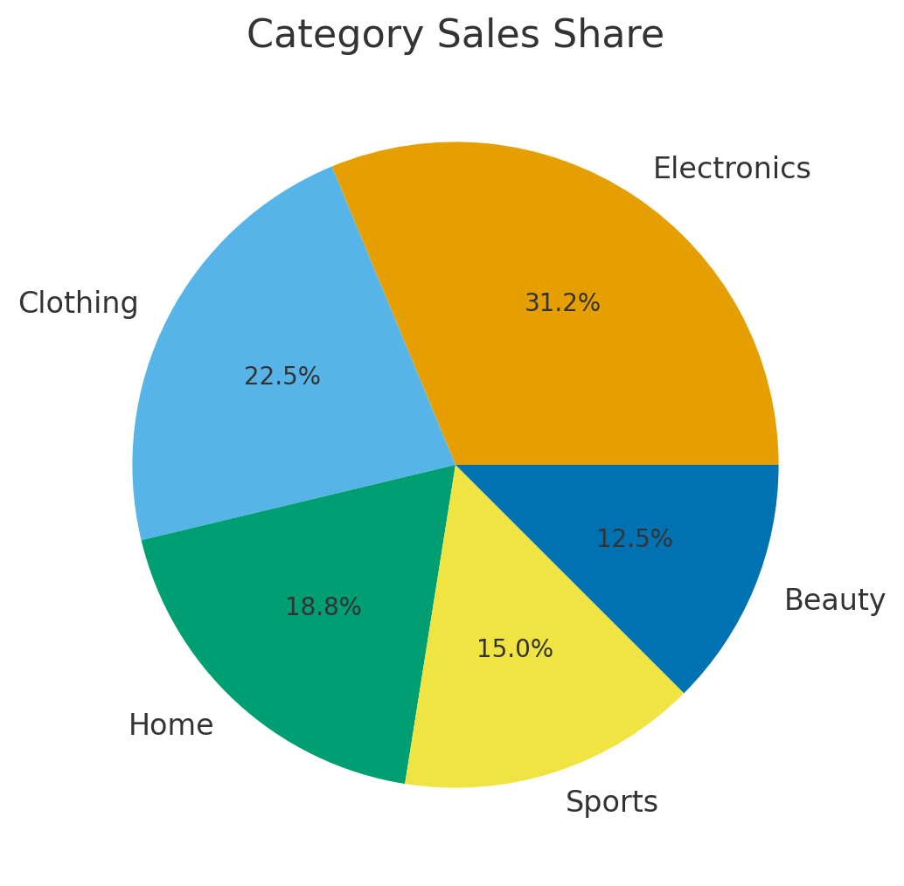
Category Sales Share

Slide 14
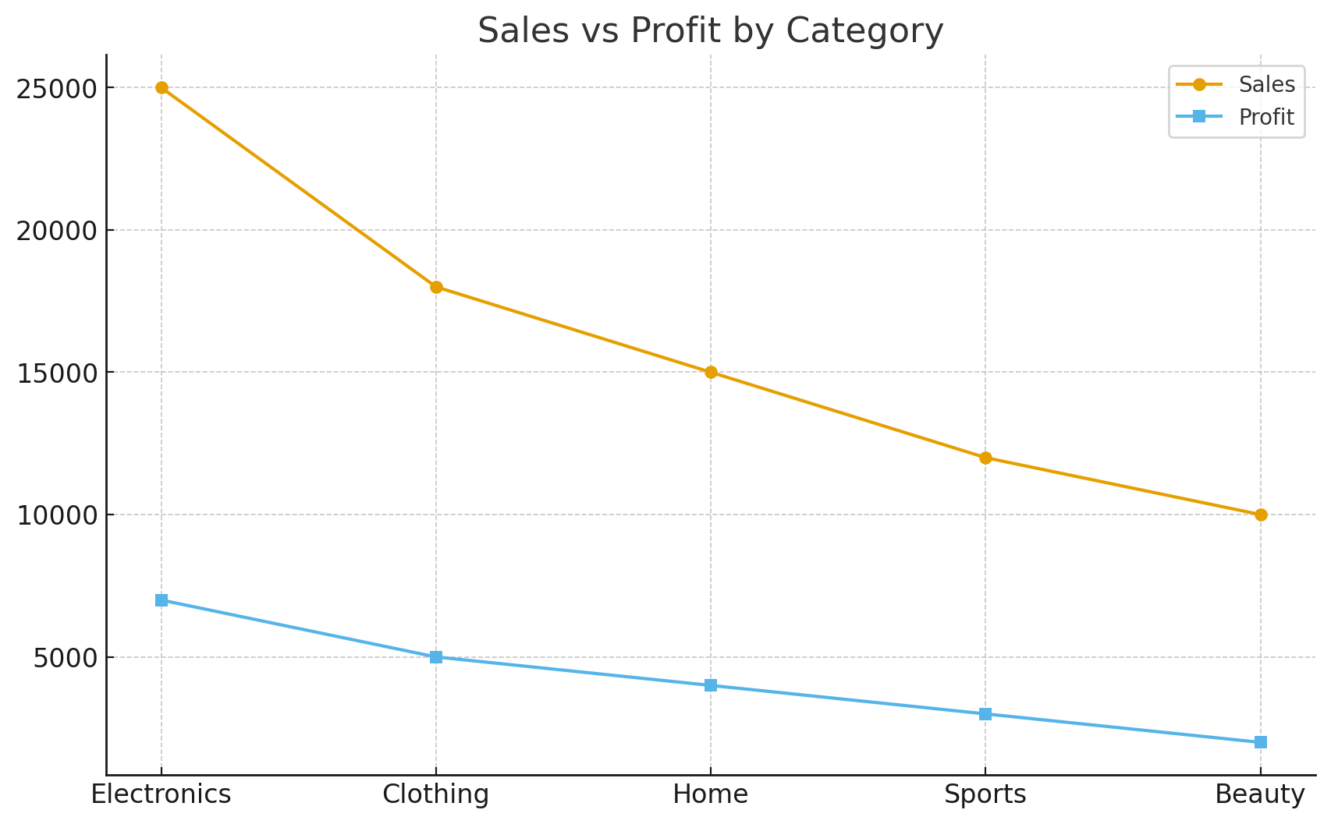
Sales vs Profit

Slide 15
Thank You
Thank You!
MUDAMANCHU GURUNAGESH (22P31A05A2)
Aditya College of Engineering & Technology (A)
[Tableau Dashboards and Visuals]

